Slide 1
Data Structures and examples of their use

Slide 2
A Data Structure is a means of storing data in memory so that it can be used efficiently
E.g. array, ArrayList, linked list, stack, queue, tree, hash table, graph etc..

Slide 3
Linked Lists
Generally used for as the basis for other data structures
Stacks
Queues
Hash tables
Graphs

Slide 4
Stacks are used at runtime for handling function/method calls – call stack
Stacks are also commonly used in parsing grammars (from simple algebraic statements to computer programming languages)
Queues are often used in system software
e.g. in a multi-user system, a printer is shared,
requests to print a file are held in a queue.
Notes:
e.g. stack used by compiler to check for matching { and } in compound statements
e.g. to evaluate an expression in standard algebraic notation (e.g. 3 x 4+5),
use 2 stacks – 1 for numbers and 1 for operators

Slide 5
Trees are used for arranging hierarchical data
E.g. file hierarchy on C: drive
Binary Search Trees are good for searching
Trees are used extensively in Database Management Systems for storing indices etc.
Game playing
At the centre of every game-playing program is a game tree
Notes:
An organisation tree records the structure of a hierarchical organisation e.g. ITTralee has schools Business Computing and Humanities, STEM and Health and Social
A game tree records:
the current position in the game
some of the possible future positions
the moves required to reach each future position
See diagram P. 387 in Java Collections by Watt and Brown

Slide 6
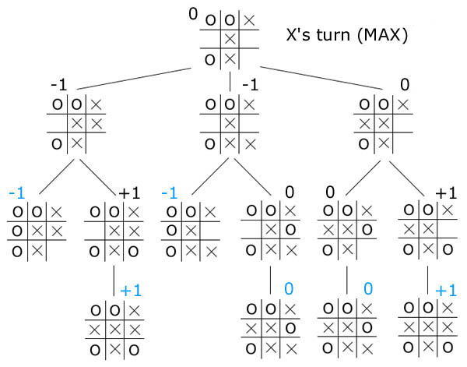
Game tree:

Slide 7
XML (eXtensible Markup Language) is a tree-structured notation for describing data.
Used to transport and store data.
See
http://www.w3schools.com/xml/xml_tree.asp
http://www.w3schools.com/xml/xml_usedfor.asp

Slide 8
Graphs occur frequently both in real life and in computing:
A road network is a graph whose nodes are cities and whose edges are roads connecting these cities.
Likewise a computer network is a collection of connected computers
Search engines like Google model the Internet as a graph:
Web pages are the nodes
Links among Web pages are the edges
Notes:
e.g. ITTralee website
Home page has links to pages for Future Students, Current Students, Graduates, Staff, Departments, etc. Each of these pages has links to other pages and back to home page
e.g. use graph to find shortest path in a maze

Slide 9
Hash tables are efficient when searching by key field
E.g. searching based on
student id number
Social security number
Car registration number
etc

Slide 10
Container or Collection classes
Container classes: classes designed to hold collections of object
i.e. a means of representing a data structure
e.g. arrays, ArrayList, linked lists, stacks, queues
Container classes provides services such as insertion, deletion, searching

Slide 11
Java provides a collections framework in the java.util package
To understand these classes we will first write some of our own.

